Slide 1
FEM2401 Malaysian Politics and Society TOPIC 4: The Federal Constitution of Malaysia
LECTURER:
MUHAMMAD AMIR BIN MUNSHI

Slide 2

Lesson 4: The Federal Constitution of Malaysia
Outline:
• Main provisions and traditional elements in the constitution
• Amendments and current Issues
LEARNING OUTCOMES:
• To explain the basic concept of a constitution
• To describe the major content of the Constitution

Slide 3
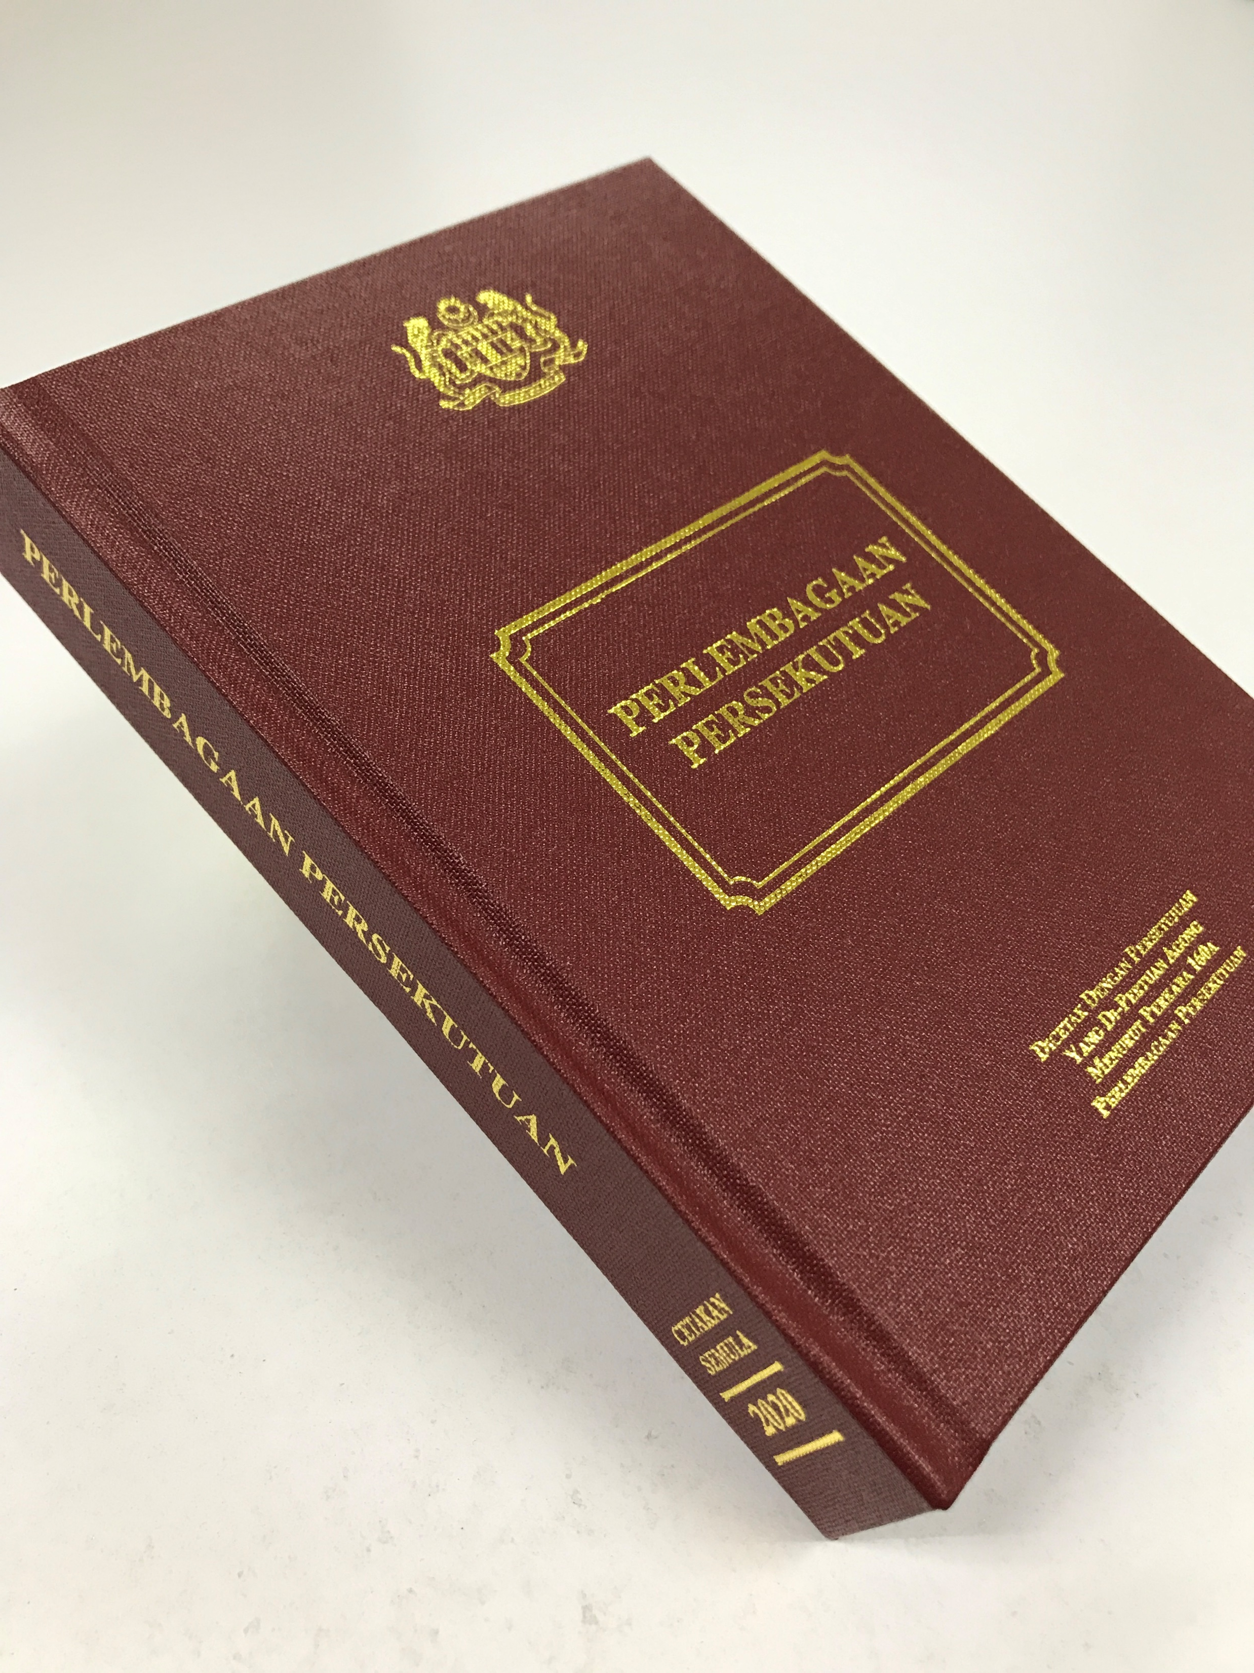
WHAT IS A CONSTITUTION?
A constitution is a statement of the basic principles and laws of a nation, state, or group
The basic principles and laws of a nation, state, or social group that determine the powers and duties of the government and guarantee certain rights to the people in it.
The basic fundamental laws of most modern nations and the highest source of legal authority (Joseph M. Fernando 2007)
A set of rules which determine the manner the institutions are to be set up, the powers to be distributed and the justice to be administered (Abdul Aziz Bari 2003)

Slide 4
Constitution around the World
The constitution of the United States of America is the oldest federal constitution of any existing country in the world today ( it written in 1787)
Shortest Constitution : Monaco (3,814 words)
Longest written Constitution : India (146,385-word)
Country with the largest number of constitution : Dominican Republic

Slide 5
WHAT ARE THE PURPOSES OF A CONSTITUTION?
To guide a government to administer the country
To maintain the sovereignty and stability of a nation
To protect the rights of the people and the institutions in the country

Slide 6
“SUPREMACY OF LAW”
A constitution as law is the supreme authority in the country
No one above the Constitution – it is supreme over Parliament, the executive or even the judiciary.

Slide 7
FORMS OF THE CONSTITUTION
TYPE | DETAILS
Written Constitution | One or more legal documents duly enacted in the form of laws. Precise, definite and systematic. It is the result of the conscious and deliberate efforts of the people. It is framed by a representative body duly elected by the people at a particular period in history. Most states of the world such as Malaysia, India, US etc.
Unwritten Constitution | • The principles of the government have never been enacted in the form of laws. • It consists of customs, conventions, traditions, and some written laws bearing different dates. • Unsystematic, indefinite and un-precise. • Not the result of conscious and deliberate efforts of the people. • UK, Canada, New Zealand

Slide 8
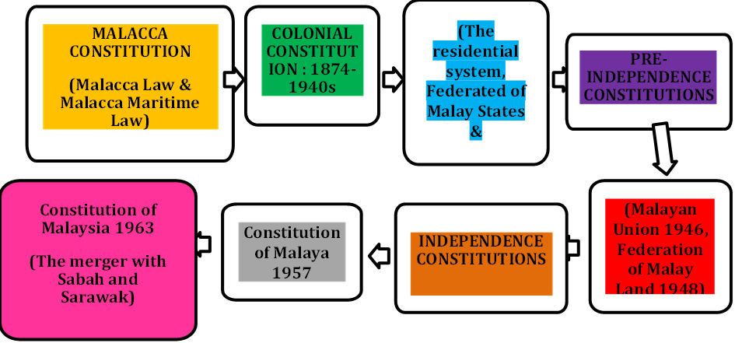
BACKGROUND OF THE FEDERAL CONSTITUTION (i)

Slide 9
BACKGROUND OF THE FEDERAL CONSTITUTION (i)
Constitution | Information
Malayan Union 1946 | After the end of the Second World War and Japan’s defeat, the British returned to Malaya and established the Malayan Union The introduction of the Malayan Union in April 1946 was opposed by the Malays and was eventually abolished
Federation of Malaya 1948 | When the Malayan Union was abolished, an agreement was made between the Malay Rulers and the British authorities, known as the Federation Agreement 1948 The agreement led to the formation of a central government, consisting of a British High Commissioner, a Legislative Council, and an Executive Council This agreement also produced a new constitution for Malaya on 1 February 1948

Slide 10
BACKGROUND OF THE FEDERAL CONSTITUTION (iI)
Constitution | Information
Reid Commission (1956) and Federation of Malaya 1957 | The Reid Commission held a referendum for all the people of Malaya,. Including the civilian, political parties, public bodies, and others, receiving 131 proposals. A draft constitution for the Federation was formed in 1957. After contributions from the Alliance and Malay rulers, the final draft was adopted into the Constitution of the Federation of Malaya on 31 August 1957 as a free and sovereign country
Constitution of Malaysia 1963 | Amendments in the 1957 Constitution was made to take into account Singapore, Sarawak, and Sabah’s entry into the Federation of Malaysia

Slide 11
REID COMMISSION
After the General Elections of 1955, the Alliance Party, which wonwith a convincing majority, demanded the British to hold a Constitutional Conference in London to enact a constitution for an independent Malaya.
This Conference formed the Federation of Malaya Constitutional Commission
Commission members | Country
Lord Reid (chairman) | UK
Sir Ivor Jennings | UK
Sir William McKell | Australia
B. Malik | India
Hakim Abdul Hamid | Pakistan

Slide 12
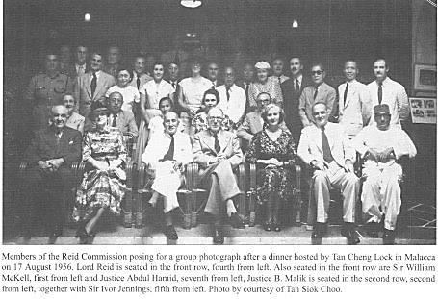
Reid Commision

Slide 13
MALAYSIAN CONSTITUTIONS
TYPE | DETAILS
Federal constitution (The Federal Constitution of Malaysia 1963) | Basic framework that provides the foundation for the whole country and federation – the merger of Malaysia with Sabah and Sarawak
State constitution | • Each state has their own constitution (13 states) Based on the provision given by the Federal Constitution

Slide 14
THE POSITION OF THE CONSTITUTION IN MALAYSIAN LEGAL SYSTEM

Slide 15
BASIS OF THE FEDERAL CONSTITUTION OF MALAYSIA
Parliamentary Democracy
Constitutional Monarchy
Federation Country (Federal and State Governments)
Doctrine of Separation of Powers (Executive, Legislative & Judiciary)
The Supremacy and Freedom of Law
Islam is the religion of federation but other religions may be practices in peace and harmony

Slide 16
THE SUPREMACY OF THE CONSTITUTION
• Supremacy means the highest in authority.
• The Federal Constitution of Malaysia is the supreme law in Malaysia.
• Article 4 (1) “This Constitution is the supreme law of the Federation and any law passed after Merdeka Day which is inconsistent with this Constitution shall, to the extent of the inconsistency, be void”.
Provision | Details
Parliament | Derives its authority from the Constitution
Constitution | Determine the concurrent list for laws which can be enacted by Parliament or State Legislative Assembly
Position of the King | His Majesty is Constitutional Monarch, Head of State, symbol of the state, symbol of the loyalty of the people. His power is derived from and limited by the Constitution
Legislative powers | The courts guarantee the supremacy of the Constitution, and ensures the law of the land is in concordance with the Constitution
Fundamental rights | The fundamental rights of Malaysians cannot be stripped by the government except in accordance with the Constitution

Slide 17
THE CONTENT OF THE CONSTITUTION
15 Parts, 183 Articles dan 13 Tables
Part 1: Name, states and territories of the Federation
Part 2: Fundamental Liberties
Part 3: Citizenship
Part 4: The Federation
Part 5: The States
Part 6: Relations between the Federation and the States
Part 7: Financial Provision
Part 8: Elections
Part 9: The Judiciary
Part 10: Public Services
Part 11: Special Powers Against Subversion, Organised Violence, and Acts and Crimes Prejudicial To The Public and Emergency Powers
Part 12: General and Miscellaneous
Part 13: Additional Protection For States of Sabah and Sarawak
Part 14: Temporary and Transitional Provisions
Part 15: Saving for Rulers’ Sovereignty

Slide 18
MAIN FEATURES IN THE CONSTITUTION
• National Language – Bahasa Melayu/Malay Language (Article 152 (1))
• Religion of the Federation– Islam (Article 3(1))
• Citizenship (Article 14 – 22)
• Special Positions of the Malays and the Natives of Sabah and Sarawak (Article.153)
• Fundamental Liberties (Article 5 – 13)

Slide 19
INDIGENOUS (TRADITIONAL) ELEMENTS/CHARACTERS IN THE CONSTITUTION
What are the indigenous elements?
• Unique elements in the constitution and could only found in Malaysian constitution
• Based on the characteristics of the Malays history and tradition
⮚ Monarchy system
⮚ Islam
⮚ Malay language
⮚ Special position of the Malays
A. Monarchy system | • Legacy of feudalism – traditional political system of the Malay states
B. Islam | • More than 600 years – is part of the Malays – religion and culture
C. Malay language | • lingua franca during the golden age of Malacca in the region
D. Special position of the Malays | • Malays are one of the earliest inhabitants and the native of Malaysia • The largest population

Slide 20
Fundamental liberties in the Constitution
• Article 5 – Life and Liberty of the Person.
• Article 6 – Prohibition of slavery and forced labour
• Article 7 – Protection against retrospective criminal and repeated trials.
• Article 8 – Equality.
• Article 9 – Prohibition of banishment and freedom of movement.
• Article 10 – Freedom of speech, assembly and association.
• Article 11 – Freedom of religion.
• Article 12 – Right to education.
• Article 13 – Right to property.

Slide 21
THE AMENDMENT OF THE CONSTITUTION
The purpose of amendments
To abolish a provision that is considered not suitable to current needs
To add a new provision that reflects the current wishes and desires of the people and the country
It is stated in Article 159 and 161E
Four methods of amendments of different provisions of the Constitution:
Requires a simple majority from both Houses of Parliament
Requires a two-thirds majority in both Houses of Parliament AND the Consent of the Conference of Rulers
Requires a two-thirds majority in both Houses of Parliament AND the Consent of the Governor of the East Malaysian State
Requires a majority of two-third in both Houses of Parliament.

Slide 22
THE EXAMPLES OF THE AMENDMENTS OF THE FEDERAL CONSTITUTION
Issue | Amendment
Separation of Singapore | Amendment made upon having 2/3 majority support of Parliament and consent of Conference of Rulers. Singapore left the Federation in August 1965
On Gender | Amended Article 8 to include the word gender – no longer laws that discriminate women
Ruler Immunity | Amendment on ruler immunity, and rulers can be brought to court
Water Supply Management | Allows the Federal Government to monitor and supervise water supply management at the state level, except in Sabah and Sarawak

Slide 23
THE ISSUES/DISPUTES REGARDING THE CONSTITUTION
Issues | Details
• Judiciary line between Civil and Syariah law
• Federal and state government relations | Finance provision
• Religious disputes | • Conversion to Islam – children custody • Apostasy • The use of ‘Allah’ term
• Ethnic tension | • “sensitive matter” • Special position of the Malays and the natives

Slide 24
CONCLUSION
The constitution of Malaysia:
A combination of democracy principles, local characteristics, traditional elements and influence of British colonial.
The highest of law of the country

